Slide 1
Network Basics

Slide 2
Outline
IP Address and Network Interface
TCP/IP Protocols
Routing
Programming using Scapy
Lab environment and containers

Slide 3
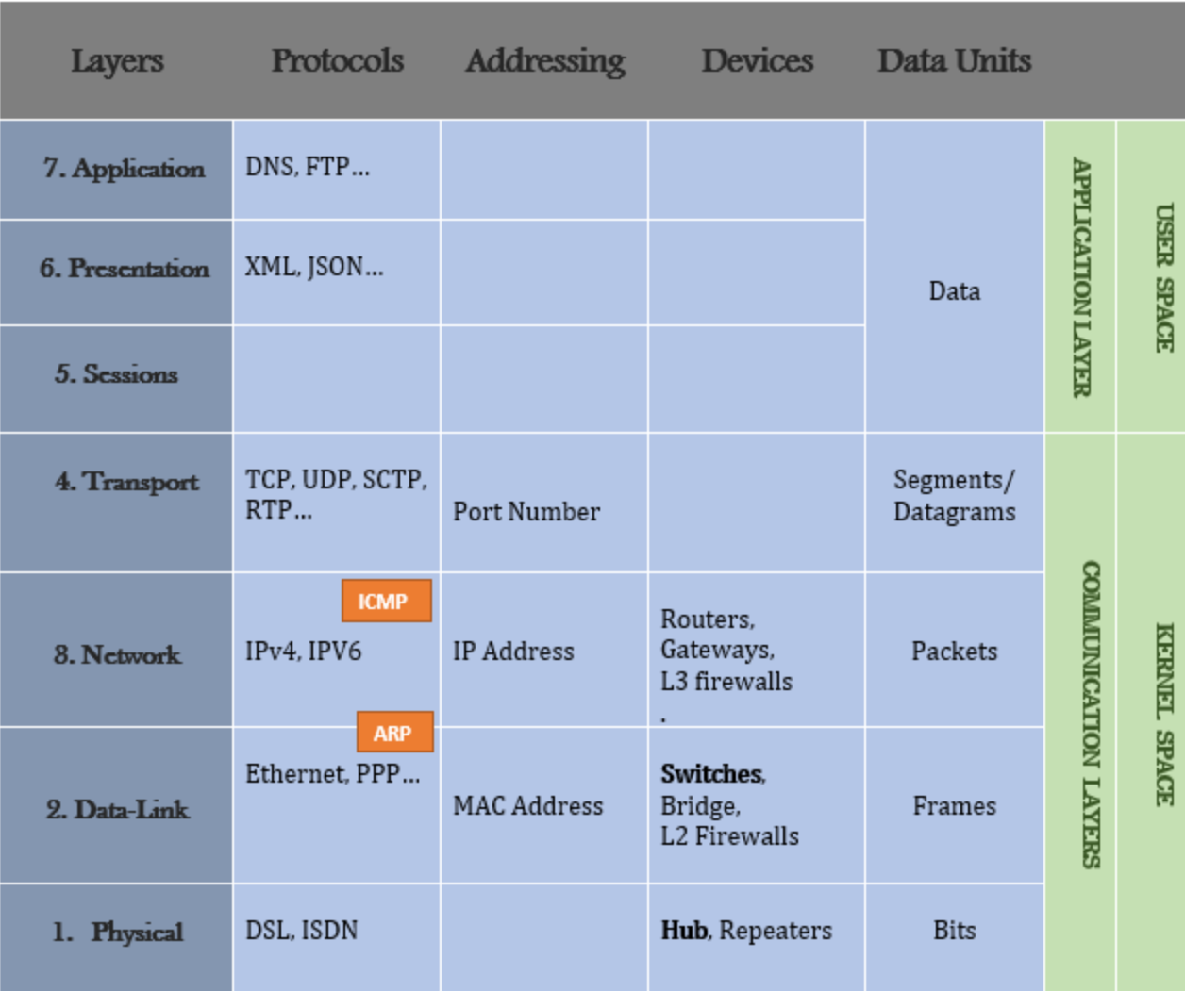
OSI Model
Source: https://0xbharath.github.io/art-of-packet-crafting-with-scapy/networking/layers/index.html
Notes:
OSI stands for Open Systems Interconnection

Slide 4
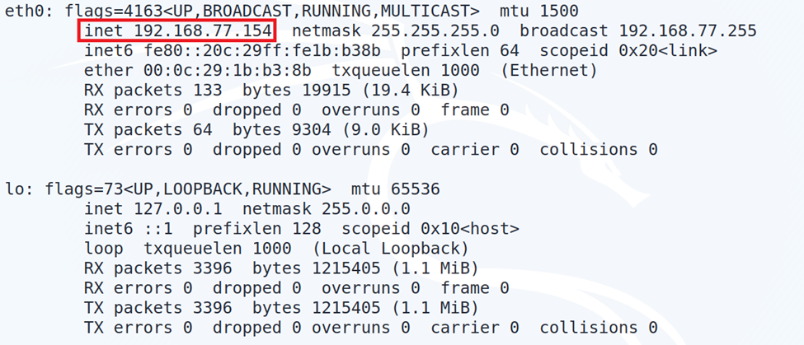
IP Addressing
IP address: 32-bit identifier for host, router interface
Interface: connection between host/router and physical link
router’s typically have multiple interfaces
host typically has one or two interfaces (e.g., wired Ethernet, wireless 802.11)
IP addresses associated with each interface

Slide 5
Subnets
Each IP address has
subnet part - high order bits
host part - low order bits
What’s a subnet ?
device interfaces with same subnet part of IP address
can physically reach each other without intervening router

Slide 6
Classful Network Addressing (1981 – 1993)
Class A:
0.0.0.0 = 00000000.00000000.00000000.00000000
127.255.255.255 = 01111111.11111111.11111111.11111111
Class B:
128.0.0.0 = 10000000.00000000.00000000.00000000
191.255.255.255 = 10111111.11111111.11111111.11111111
Class C
192.0.0.0 = 11000000.00000000.00000000.00000000
223.255.255.255 = 11011111.11111111.11111111.11111111
Class D
224.0.0.0 = 11100000.00000000.00000000.00000000
239.255.255.255 = 11101111.11111111.11111111.11111111
Class E
240.0.0.0 = 11110000.00000000.00000000.00000000
255.255.255.255 = 11111111.11111111.11111111.11111111

Slide 7
Classless Inter-Domain Routing (CIDR)
Subnet portion of address of arbitrary length
Address format: a.b.c.d/x, where x is the number of bits in subnet portion of address
https://www.ipaddressguide.com/cidr

Slide 8
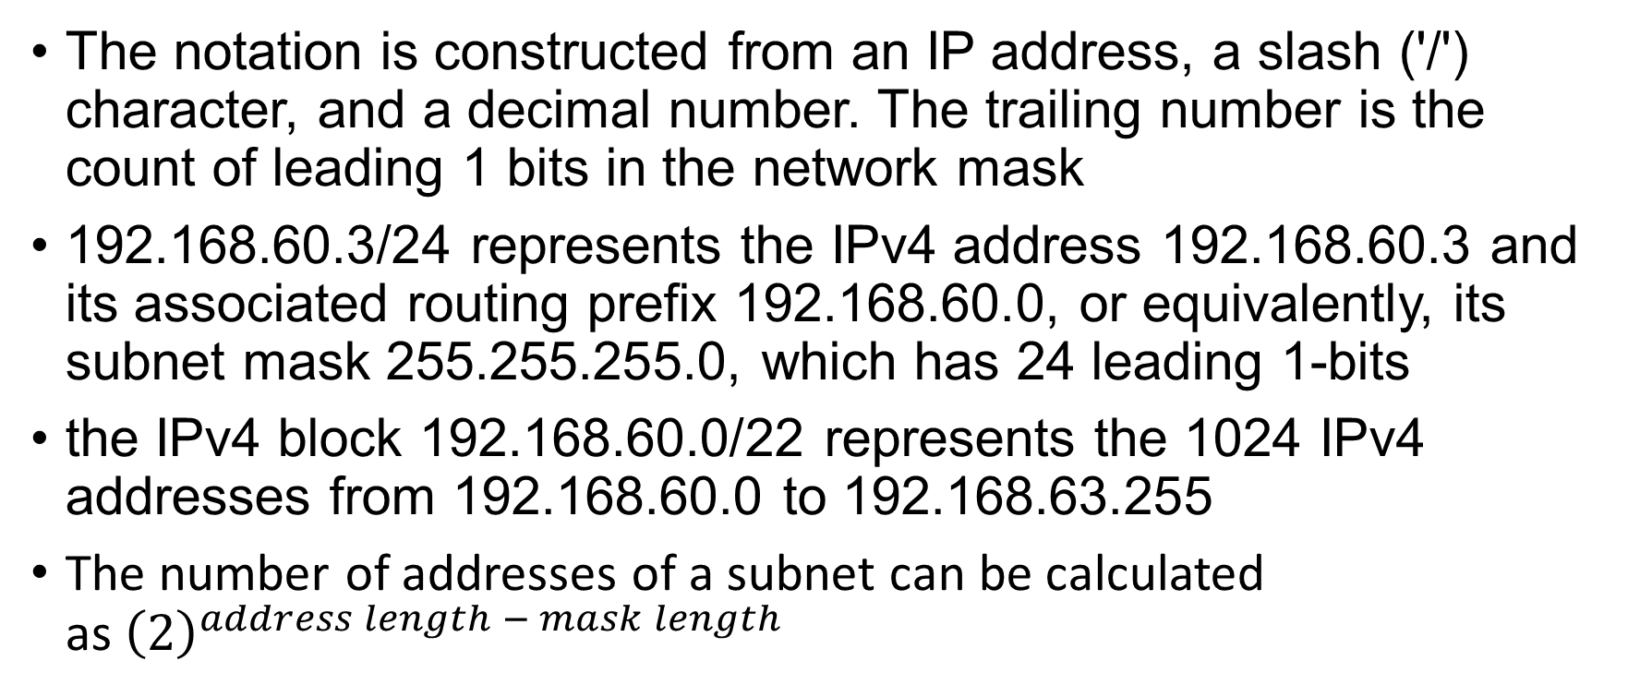
Classless Inter-Domain Routing (CIDR)
The notation is constructed from an IP address, a slash ('/') character, and a decimal number. The trailing number is the count of leading 1 bits in the network mask
192.168.60.3/24 represents the IPv4 address 192.168.60.3 and its associated routing prefix 192.168.60.0, or equivalently, its subnet mask 255.255.255.0, which has 24 leading 1-bits
the IPv4 block 192.168.60.0/22 represents the 1024 IPv4 addresses from 192.168.60.0 to 192.168.63.255
The number of addresses of a subnet can be calculated as${\left(2\right)}^{address length − mask length }$
Notes:
60 -> 00111100

Slide 9
Classless Inter-Domain Routing (CIDR)
192.168.60.5/24
Indicate the first 24 bits are network ID
Question: What is the address range of the network 192.168.192.0/19 ?
Notes:
192 = 110 00000
The first three bits are network ID. If we use binary to represent the third byte, the range is
192.168.(110 00000).0 to 192.168.(110 11111).FF, i.e., it is 192.168.192.0 to 192.168.223.255.

Slide 10
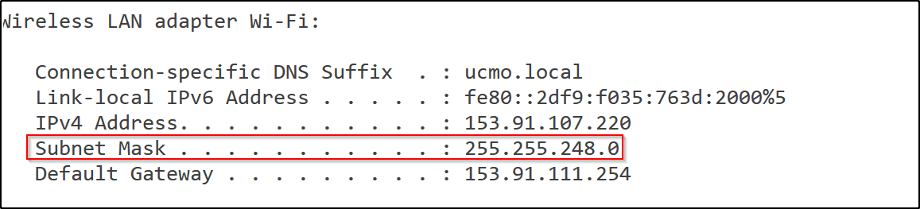
An Example
255.255.248.0 – 11111111.11111111.11111000.00000000
153.91.107.220 – 10010111.01011011.01101011.11011100
Address range
10010111.01011011.01101000.00000000 - 153.91.104.0
10010111.01011011.01101111.11111111 – 153.91.111.255

Slide 11
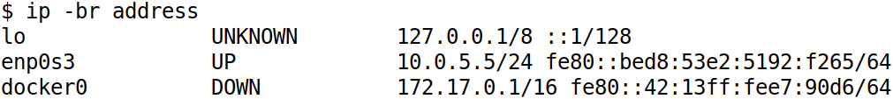
List IP Address on Network Interface

Slide 12
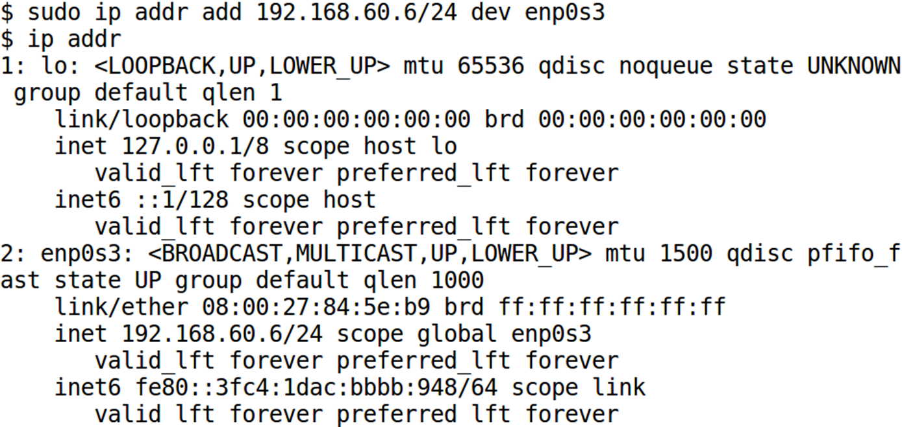
How Do Hosts Get IP Address
Automatically assign IP addresses to hosts
Dynamic Host Configuration Protocol (DHCP)
Manually assign IP addresses to hosts
$ sudo ip addr add 192.168.60.6/24 dev enp0s3 or
$ sudo ifconfig enp0s3 192.168.60.6/24 up

Slide 13
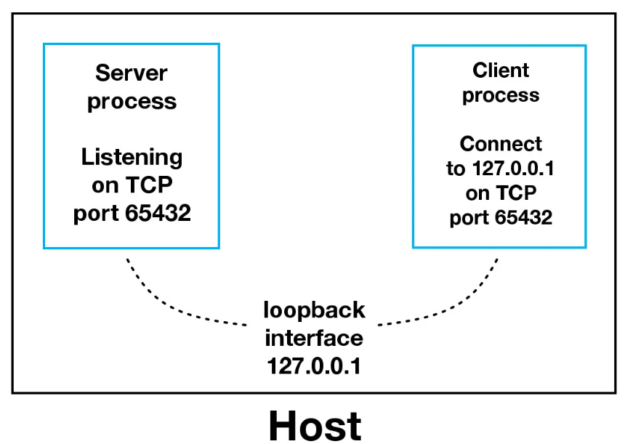
Special IP Addresses
Private IP Addresses
10.0.0.0 to 10.255.255.255 (10.0.0.0/8)
172.16.0.0 to 172.31.255.255 (172.16.0.0/12)
192.168.0.0 to 192.168.255.255 (192.168.0.0/16)
Loopback Addresses
127.0.0.0/8
127.0.0.1 is the most widely used
Link-local Addresses
In case a host is not able to acquire an IP address from the DHCP server and it has not been assigned any IP address manually, the host can assign itself an IP address from a range of reserved Link-local addresses
169.254.0.0/16
Link-local address is not routable and thus host cannot access the internet. The host can only communicate with other devices on the same LAN

Slide 14
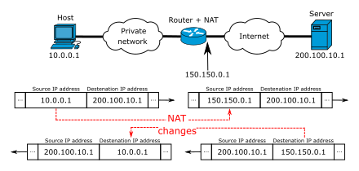
Network Address Translation (NAT)
Credit: Michel Bakni

Slide 15
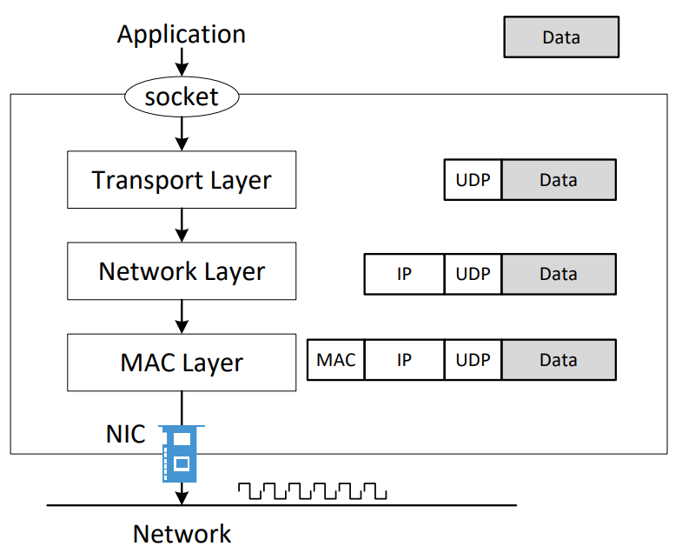
How Packets Are Constructed

Slide 16
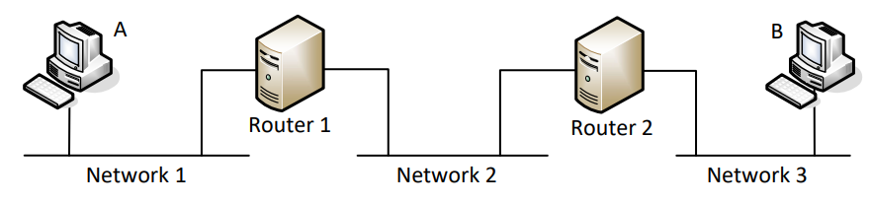
Packet Journey at High Level
Notes:
Use this diagram to illustrate how packet is sent from A to B, hop by hop.

Slide 17
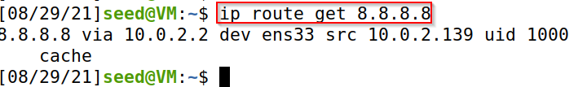

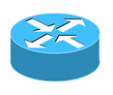

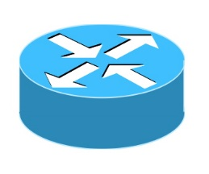


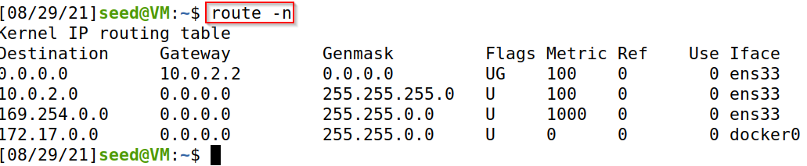
Sending Packets Hop by Hop
R3
Internet
R1
Rn
R2
subnet
subnet

Slide 18
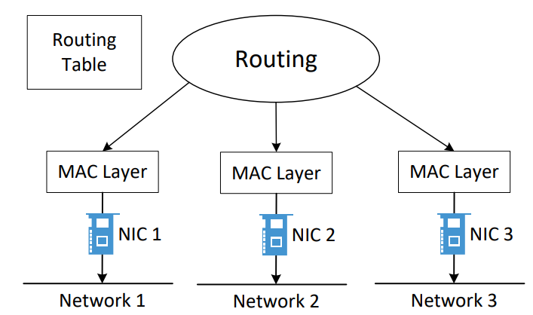
Routing

Slide 19
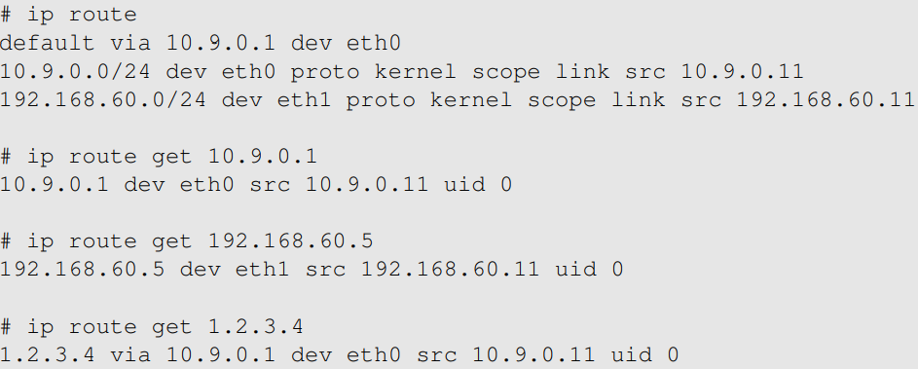
The “ip route” Command

Slide 20
Routing Rules
What interface will be used to route packets to
192.100.60.3
192.168.30.3
192.168.60.3
A: 0.0.0.0/0 dev interface-a
B: 192.168.0.0/16 dev interface-b
C: 192.168.60.0/24 dev interface-c
D: 192.168.60.3/32 dev interface-d

Slide 21
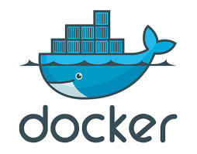
Docker
A set of platform as a service (PaaS) products that use OS-level virtualization to deliver software in packages called containers
Docker uses the resource isolation features of the Linux kernel to allow containers to run within a single Linux instance, avoiding the overhead of starting and maintaining virtual machines.
Docker container uses fewer resources than virtual machines. Docker containers are lightweight, a single server or virtual machine can run several containers simultaneously
Docker tutorial https://docker-curriculum.com/
Notes:
PaaS stands for Platform as a service

Slide 22
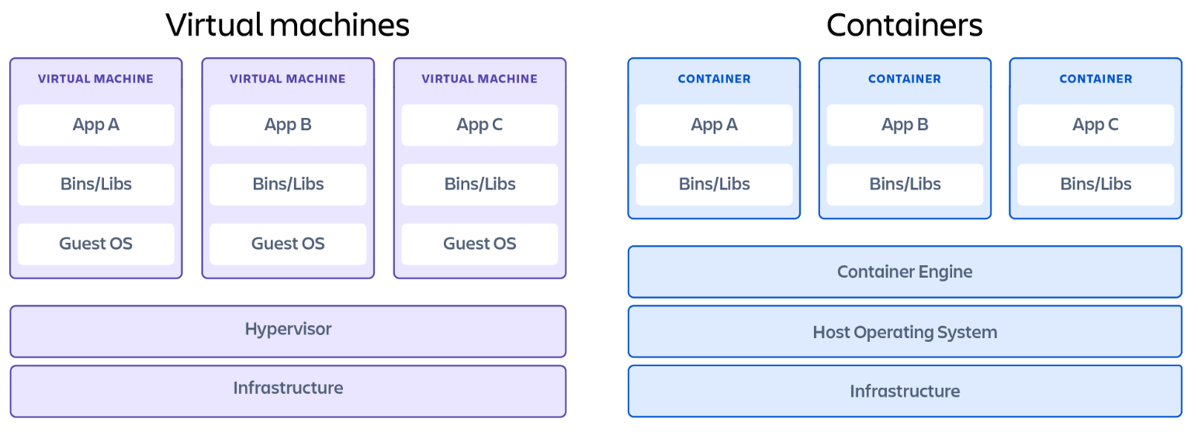
Containers vs. Virtual Machines
Notes:
Applications running on VM system can run different OS. While applications running in a container environment share a single OS

Slide 23
Containers vs. Virtual Machines
Virtual Machines | Containers
Applications running on VM system can run different OS | While applications running in a container environment share a single OS
VM virtualizes the computer system | While containers virtualize the operating system only
VM size is very large | While the size of container is very light; i.e. a few megabytes
VM takes minutes to run, due to large size | While containers take a few seconds to run
VM uses a lot of system memory | While containers require very less memory
VM is more secure | While containers are less secure

Slide 24
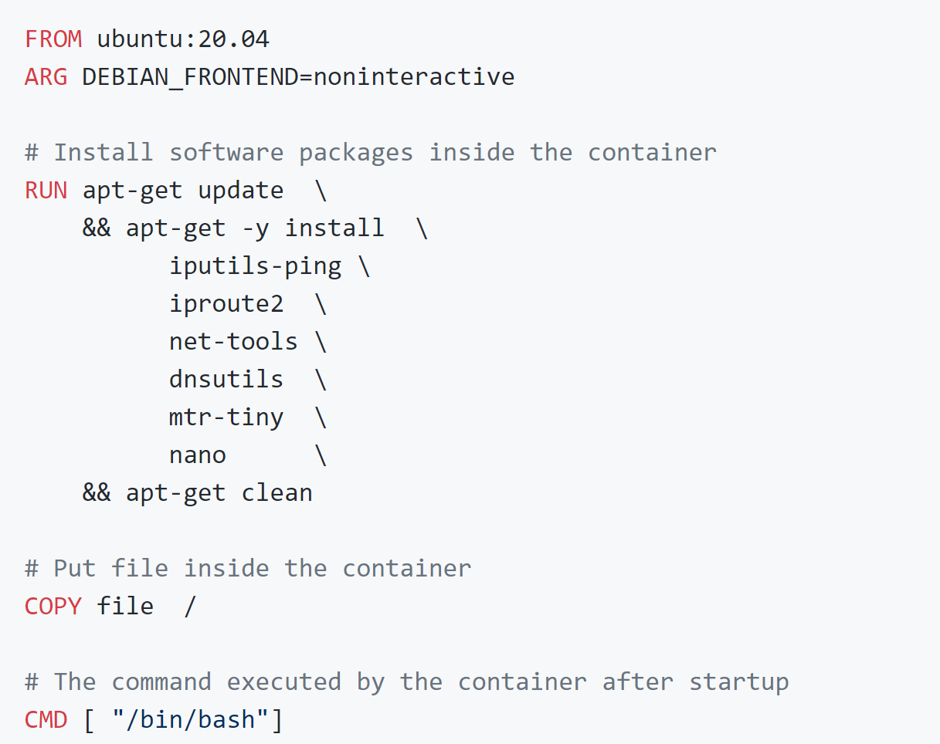
Dockerfile
Docker can build images automatically by reading the instructions from a Dockerfile - a text file that contains all commands needed to build a container image
FROM instruction - indicates the container is built on top of the official Ubuntu 20.04 Docker image
RUN instruction - install a number of additional software packages
COPY instruction copies new files or directories from <src> and adds them to the file system of the container at the path <dest>

Slide 25
Useful Docker Commands
docker build -t myhost: builds a Docker image called myhost using the Dockerfile in the current directory
docker ps: List all the running containers, including the ID for each container. Use -a to list all containers (include those stopped)
docker exec -it <container id> /bin/bash: Execute the /bin/bash command in a running container
docker rm <container id>: Stop and remove a container
docker network create --subnet=10.9.0.0/24 mynetwork: creates a network called mynetwork with network prefix 10.9.0.0/24
docker run --net mynetwork --ip 10.9.0.3 --rm -it myhost: starts the container. -it tells Docker we want an interactive session

Slide 26
Docker Compose
A tool for defining and running multi-container Docker applications
It uses YAML files to configure the application's services and performs the creation and start-up process of all the containers with a single command

Slide 27
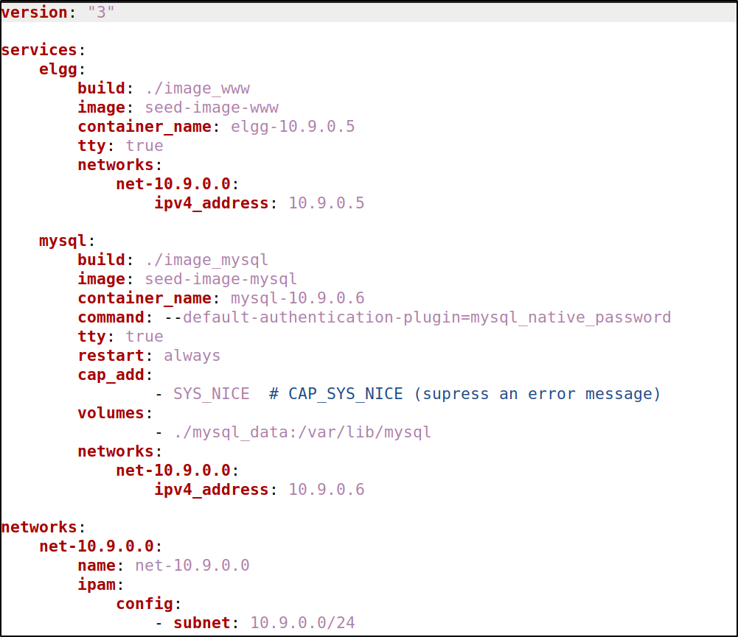
Sample docker-compose.yml File
The services section lists all the containers that we want to build and run
The networks section lists all the networks that we need to create. Each network is given a name, and the name is used by the container entries
When Docker creates a network, it automatically attaches the host machine (i.e., the VM) to the network, and gives the .1 as its IP address (i.e., 10.9.0.1). Therefore, the host machine can directly communicate with all the containers

Slide 28
Sample docker-compose.yml File
build entry: indicates that the container image's folder name, and will use the Dockerfile inside to build a container image. If a service does not have a build entry, it means the container does not need to build its own image; it uses the existing image specified in the image entry
image entry: The name of the image is specified in this entry. Without this entry, docker will generate a name for this image
container_name entry: name of the container
networks entry: It specifies the name of the networks that this container is attached to, along with the IP address assigned to the container. Multiple networks can be attached to a container
tty: true: to obtain an interactive session on the container (i.e., getting a shell prompt on the container later on)

Slide 29
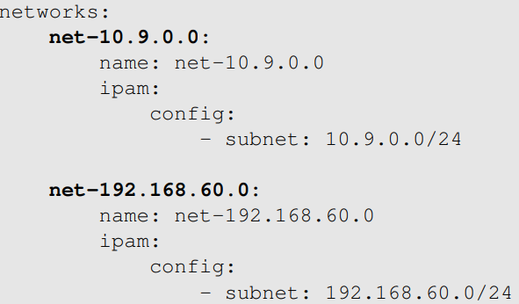
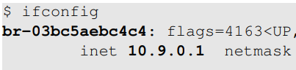
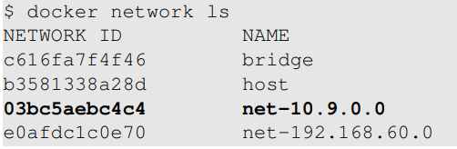
Set Up Networks
Find out interface name

Slide 30
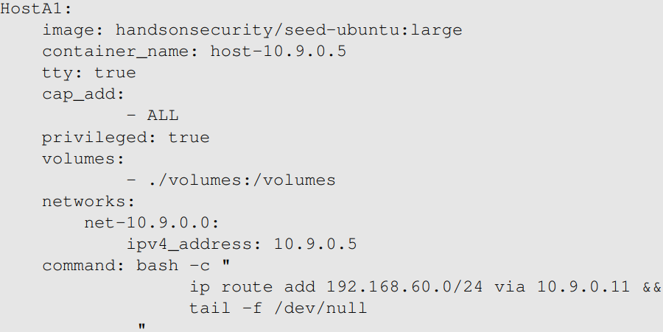
Set Up Hosts
Notes:
Explain the purpose of each entry.

Slide 31
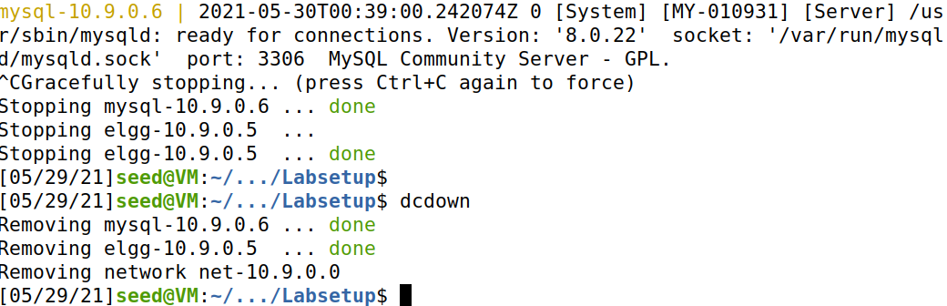
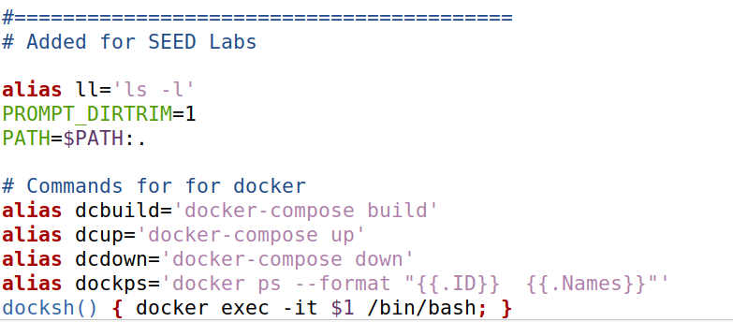
Building, Starting, Stopping Containers
docker-compose build: build the container images specified in the docker-compose.yml file contained in the current directory
docker-compose up: start all the containers specified in the docker-compose.yml file
If you want to run your services in the background, you can pass the -d flag (for “detached” mode) to docker-compose up
docker-compose down: stop and removing all the containers

Slide 32
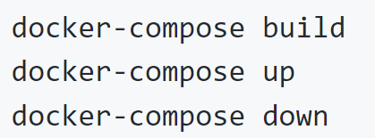
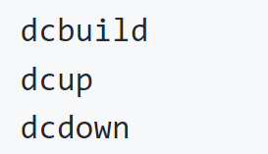
Start/Stop Containers
Alias created in the SEED VM

Slide 33
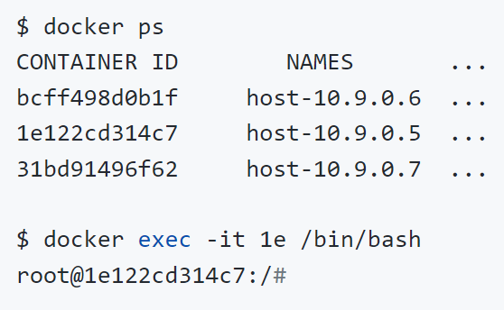
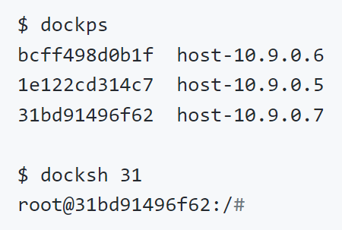
Get Into A Container
Alias created in the SEED VM

Slide 34
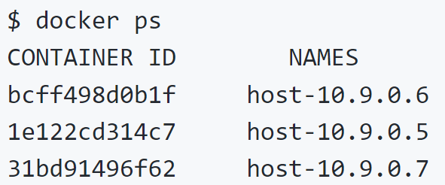
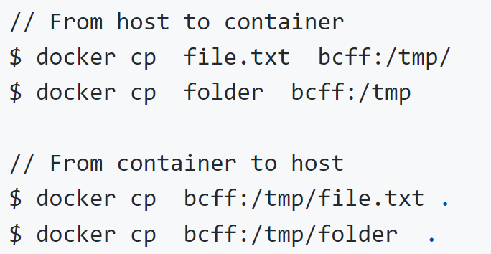
Copy Files Between Host and Container
Get container ID

Slide 35

Scapy
Scapy is a packet crafting, manipulation and analysis suite
Scapy is an environment based on Python
Installation
$ sudo pip3 install scapy
Import Scapy Module in Python Programs
from scapy.all import *
To start Scapy, you have to invoke it with UID 0 privileges on Linux
$ sudo scapy
Exit Scapy, press CTRL-D
A very good tutorial: https://0xbharath.github.io/art-of-packet-crafting-with-scapy/index.html

Slide 36
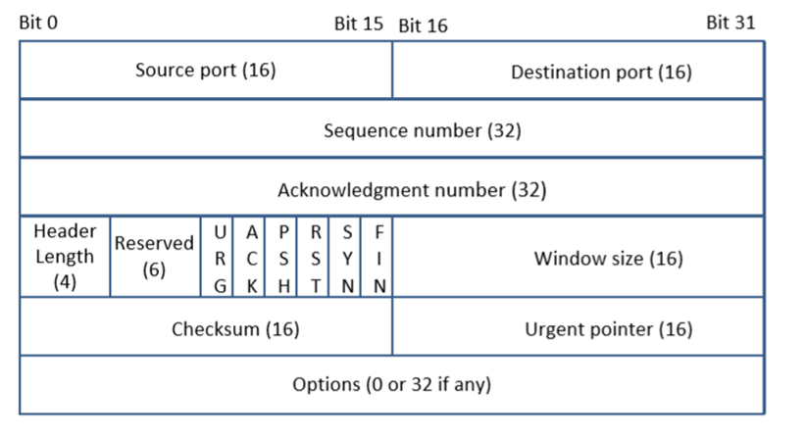
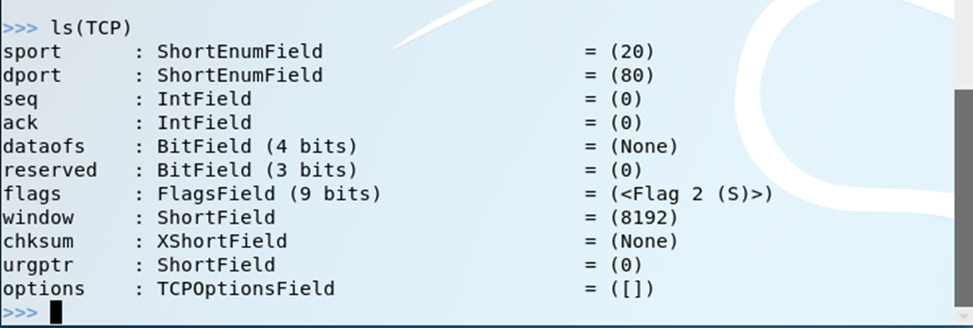
Listing Protocols
Use ls() command to list all protocols supported by Scapy
ARP, IP, ICMP, TCP, UDP, Ether, etc.
To see the fields you can set within a given protocol, type ls([PROTO])

Slide 37
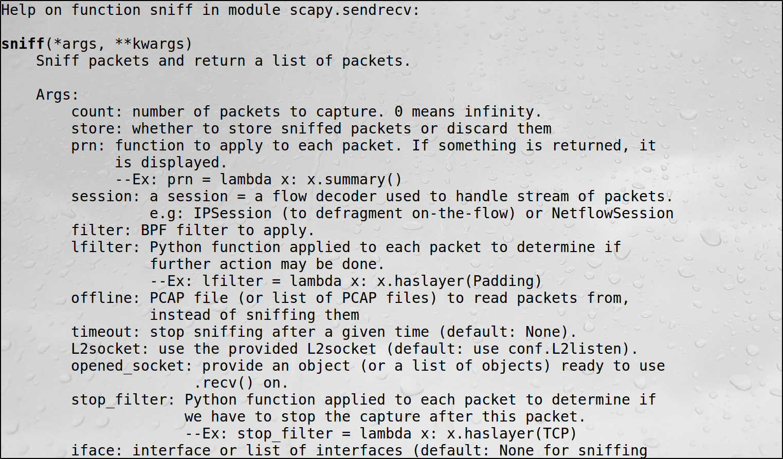
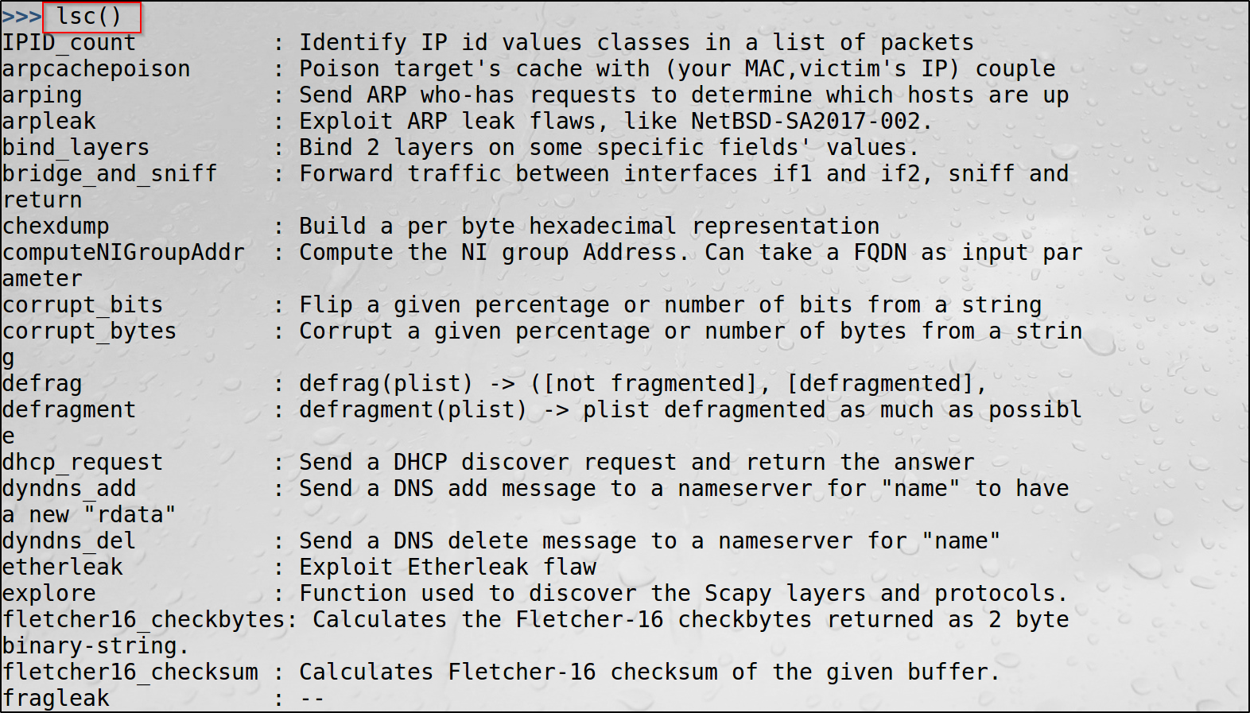
Listing Commands
lsc() commands shows all Scapy functions
To get help with any function/class, type
help([function/class])

Slide 38
How Packets Are Constructed

Slide 39
Creating Packets
Packets are constructed by layers
Build from lower layers up to higher layers moving from left to right
Separate layers with /
Override default value for field with <field>=<value>
packet=IP(dst="192.168.1.81")/TCP(dport=23)/"Hello World"
ls(packet)

Slide 40
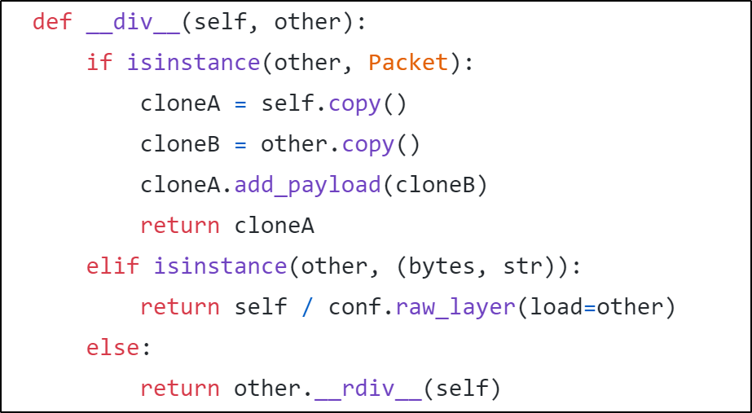
Layer Stacking
Operator Overloading (packet.py)

Slide 41
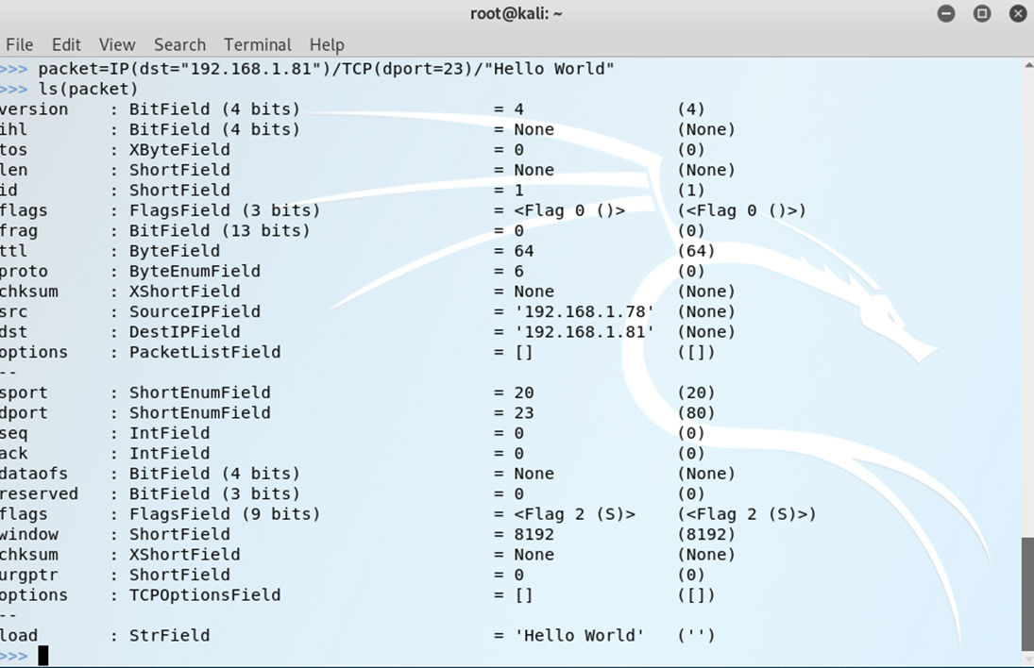
Making Packets

Slide 42
Inspecting Packets
packet
packet.summary()
packet.show()
ls(packet)

Slide 43
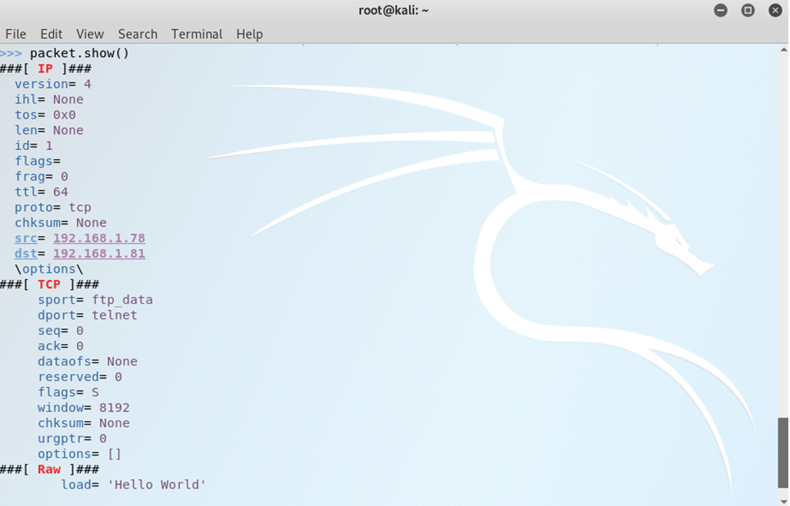
Inspecting Packets

Slide 44
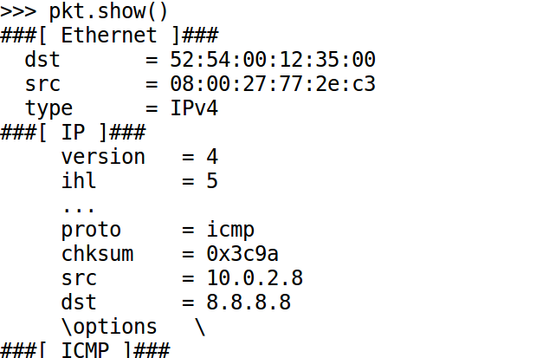
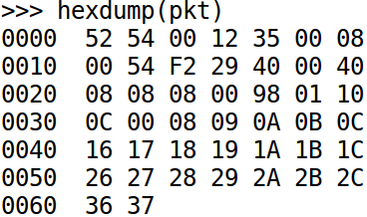
Inspecting Packets
Using hexdump()
Using pkt.show()

Slide 45
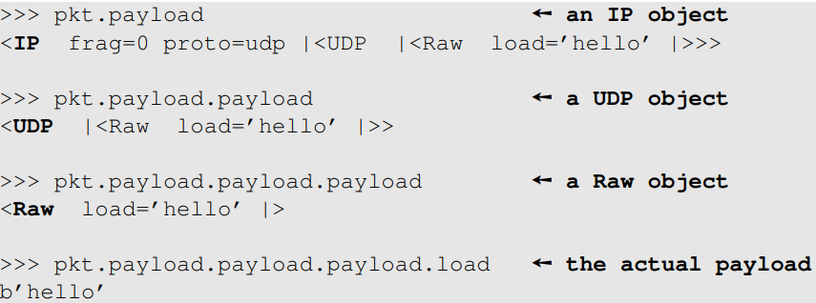
Slicing the Protocol Layers
It is a binary string

Slide 46
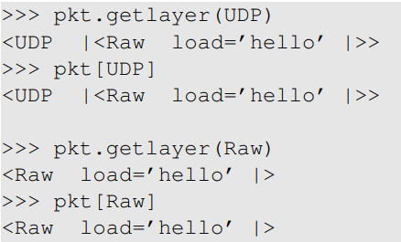
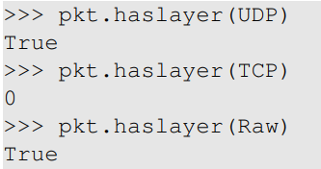
Accessing Layers
Get inner layers
Check layer existence

Slide 47
Inspecting Packet Fields
You can view the value of an individual field in a packet by using packet_name.field_name
If the field name is not unique across the protocol layers, use packet_name[proto].field_name
For example
packet[TCP].flags
After creating a packet, you can change any field in the packet by using packet_name.field_name = value
If the field is not unique, use packet_name[proto].field_name = value

Slide 48
Specifying Addresses and Ports
Single target
packet=IP(dst=“198.162.1.81”)
CIDR notation
packet=IP(dst=“198.162.1.0/24”)
Multiple targets
packet=IP(dst=[“198.162.1.1”,“198.162.1.3”,“198.162.1.6”])
Create packet destined for ports 1-1000
packet=IP(dst=“198.162.1.81”)/TCP(dport=(1,1000))
For a list of ports, type
packet=IP(dst=“198.162.1.81”)/TCP(dport=[23,80,443])

Slide 49
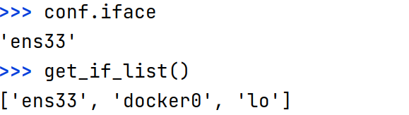
Sending Packets
send()/sendp(): send packets and don’t receive any response back
sr()/srp(): send and receive packets
sr1()/srp1(): send packets and returns only the first answer
srloop()/srploop(): send the same packets continuously
Most of the send/receive functions have the following options
iface: the interface used to send the packets. If not specified, the default value in conf.iface will be used
filter = [bpf packet filter]
count = N: send N packets
retry = N: resend packet up to N times if no response is received
timeout = N: wait only N seconds for a response

Slide 50
Reading and Writing Packets
To get packet from a pcap file
>>> rdpcap(“filename”)
To write packets to a file
>>> wrpcap(“filename”, packets)
To view packets in Wireshark
>>> wireshark(packets)

Slide 51
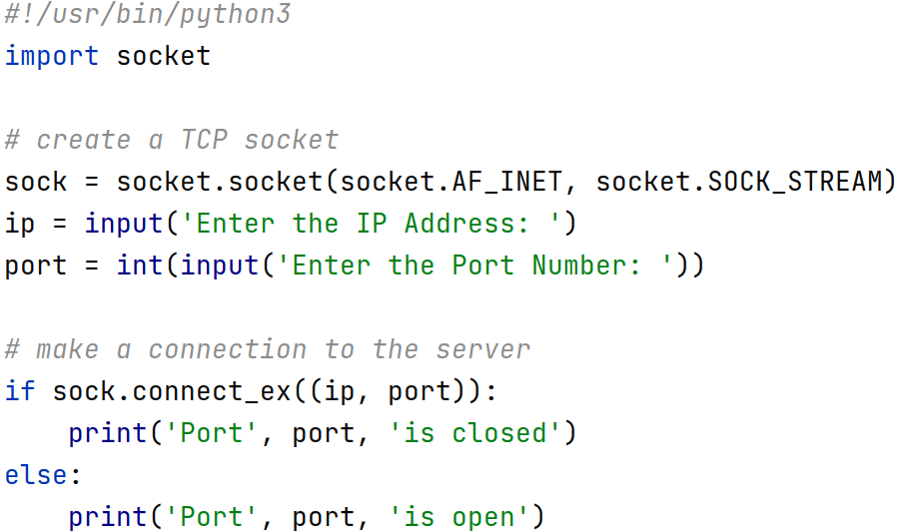
Python Scripting
https://www.w3schools.com/python/default.asp

Slide 52
Some Remarks
Python is case sensitive
Indentation is important
# used for comments
In Python everything is an object
#!/usr/bin/python3: specify the Python interpreter to use
input: get the input as a string
int: convert the string into integer
socket.AF_INET: IPv4 network
socket.SOCK_STREAM: TCP
socket.SOCK_DGRAM: UDP

Slide 53
Python Built-in Data Types
Python has the following data types built-in by default
Text Type: str
Numeric Types: int, float
Sequence Types: list, tuple, range
Mapping Type: dict
Boolean Type: bool
Binary Types: bytes, bytearray
Notes:
To generate a single 0xFF byte, use b'\xff' or bytes([0xff])

Slide 54
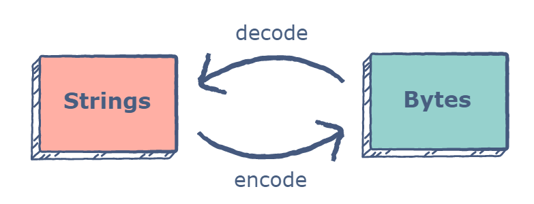
Strings Vs. Bytes
A byte object is a sequence of bytes. These byte objects are machine-readable and can be directly stored on the disk
Bytes, an immutable sequence of integers in the range 0 <= x < 256. bytearray - similar to bytes, but mutable
Strings, on the other hand, are in human-readable form and need to be encoded so that they can be stored on a disk
There are several different types of encodings that can map text to the disk. The most popular ones are the​ ASCII and UTF-8 encoding techniques

Slide 55
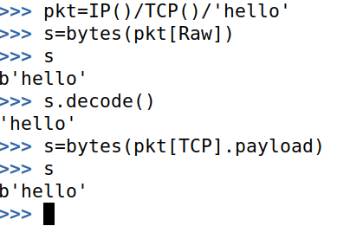
Convert Strings to Bytes
We can use the built-in Bytes class in Python to convert a string to bytes
Simply pass the string as the first input of the constructor of the Bytes class and then pass the encoding as the second argument
Printing the object shows a user-friendly textual representation, but the data contained in it is​ in bytes

Slide 56
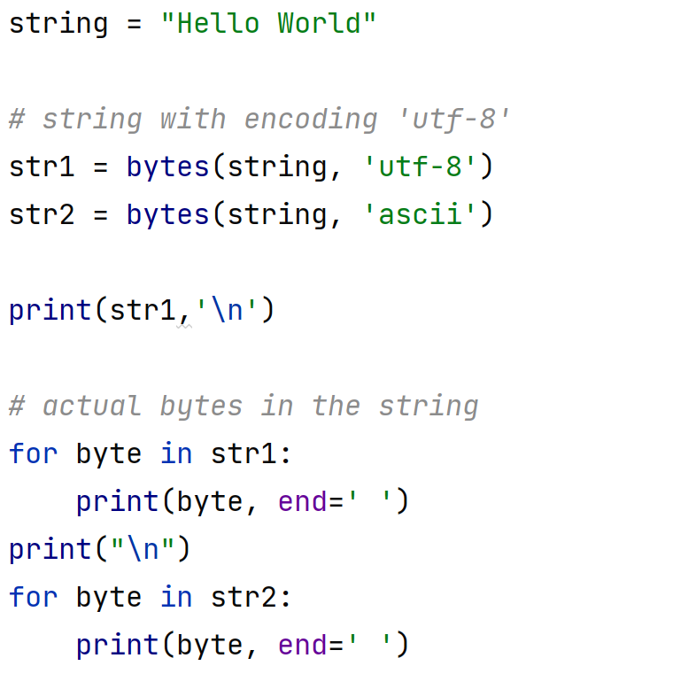
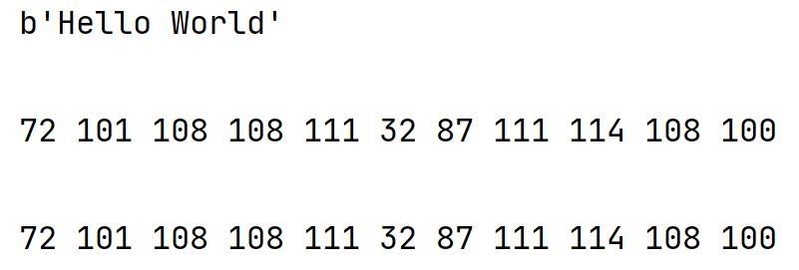
Convert Strings to Bytes

Slide 57
Obtaining Inputs from Command Line
For many scripts used for security domain, it is highly desirable to obtain inputs from command line instead of hardcoding inside the script
The arguments passed from the command line will be stored in the argv (a list of strings) of Python’s sys module
argv[0] is the script name, argv[1] represents the first input, argv[2] represents the second input, etc.

Slide 58





Port Scan Script with Command Line Inputs

Slide 59

Example: implement ping
Notes:
ICMP might need to have a non-zero id field. Otherwise, no reply will be received

Slide 60

Example: implement traceroute

